Slide 1
Sports Buddy Scrum Plan V2
The Sports Buddy Team

Slide 2
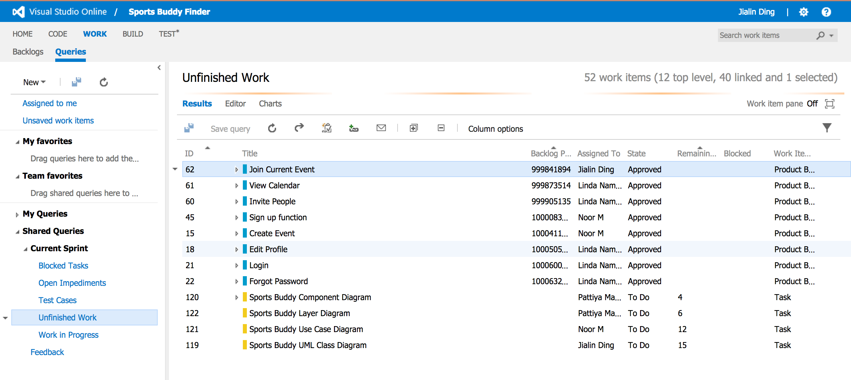
Overview

Slide 3
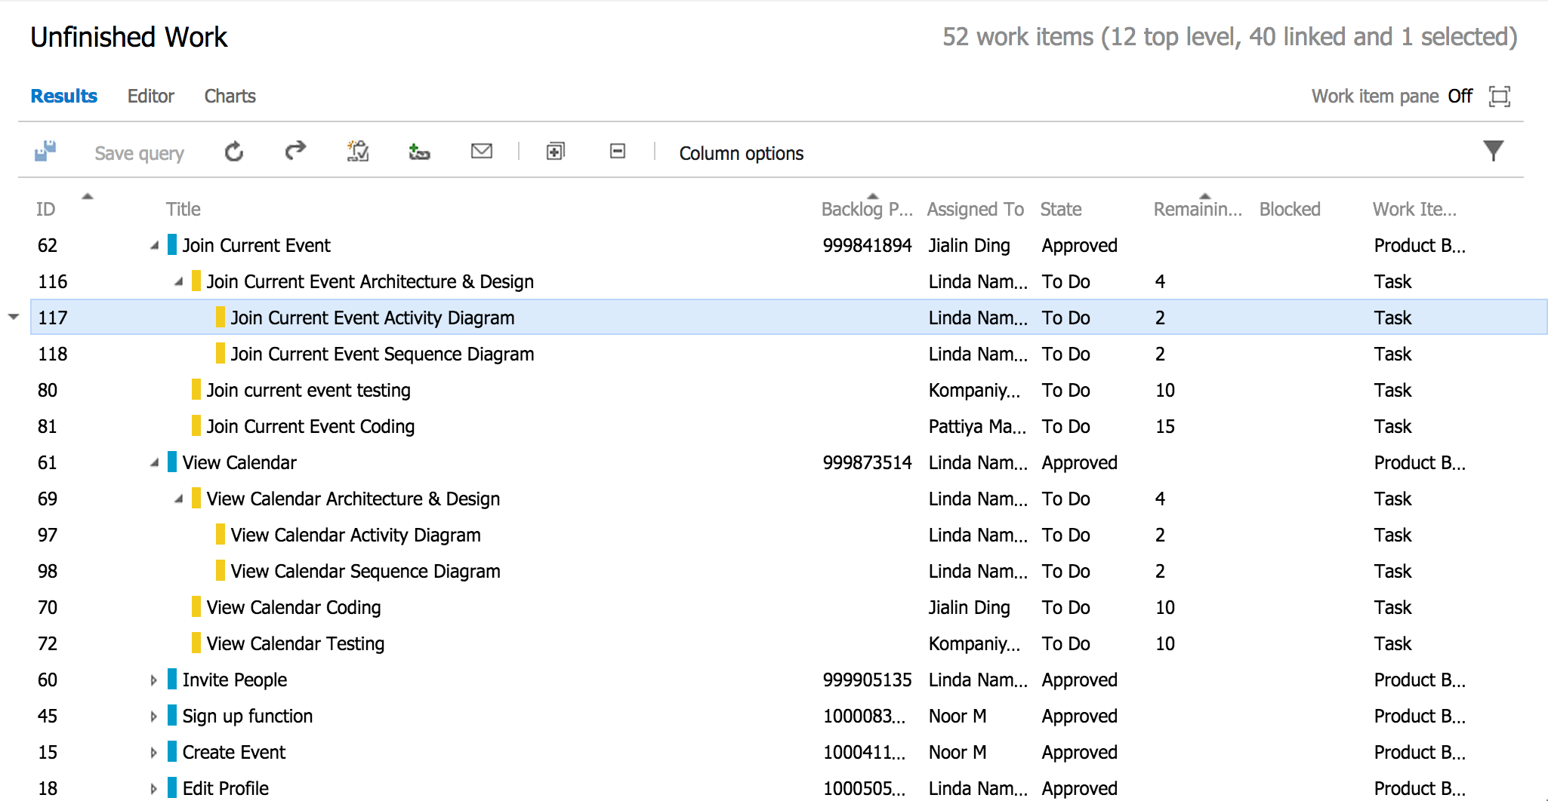
Unfinished Tasks Details

Slide 4
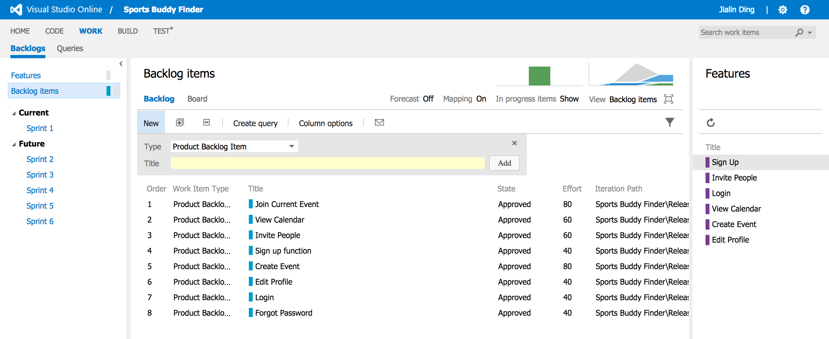
Backlog Items

Slide 5
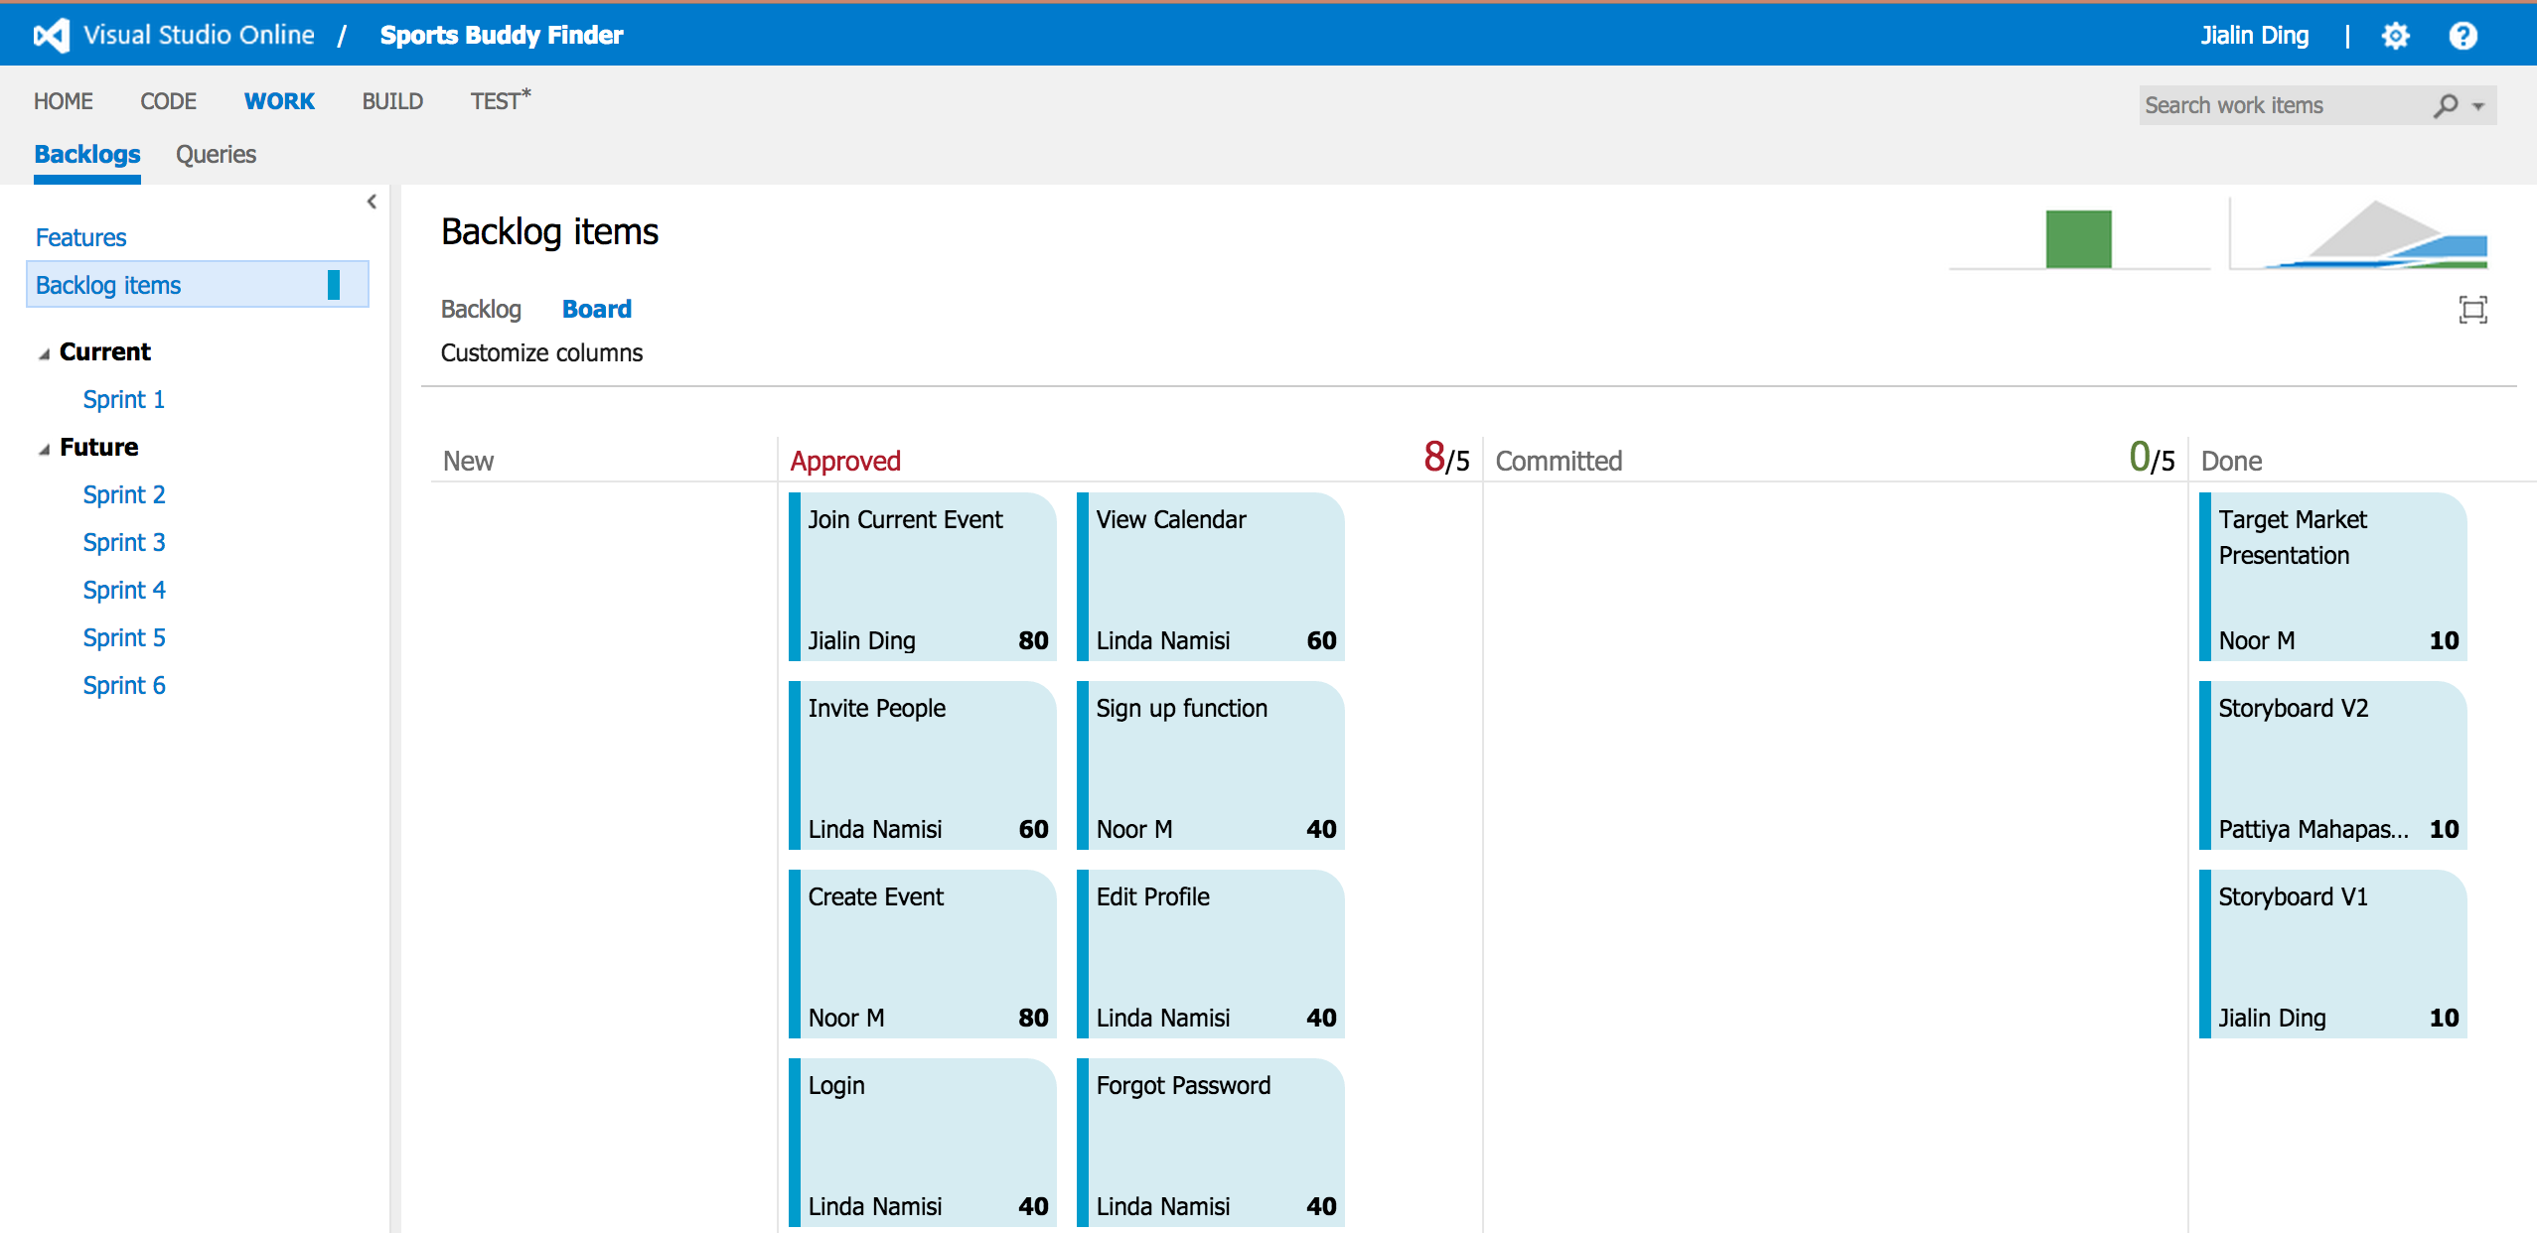
Approved Backlog Items

Slide 6
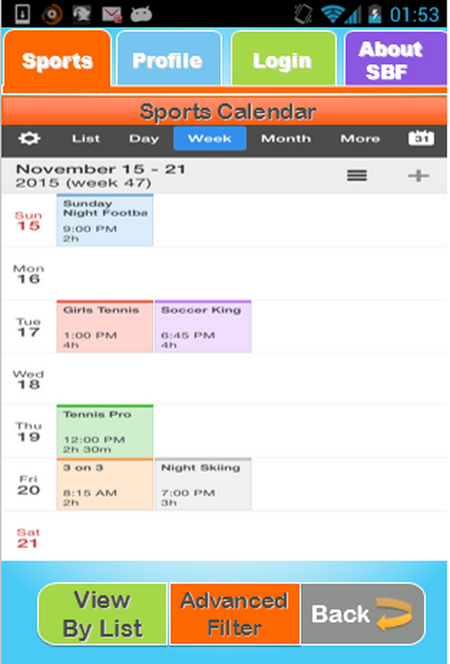
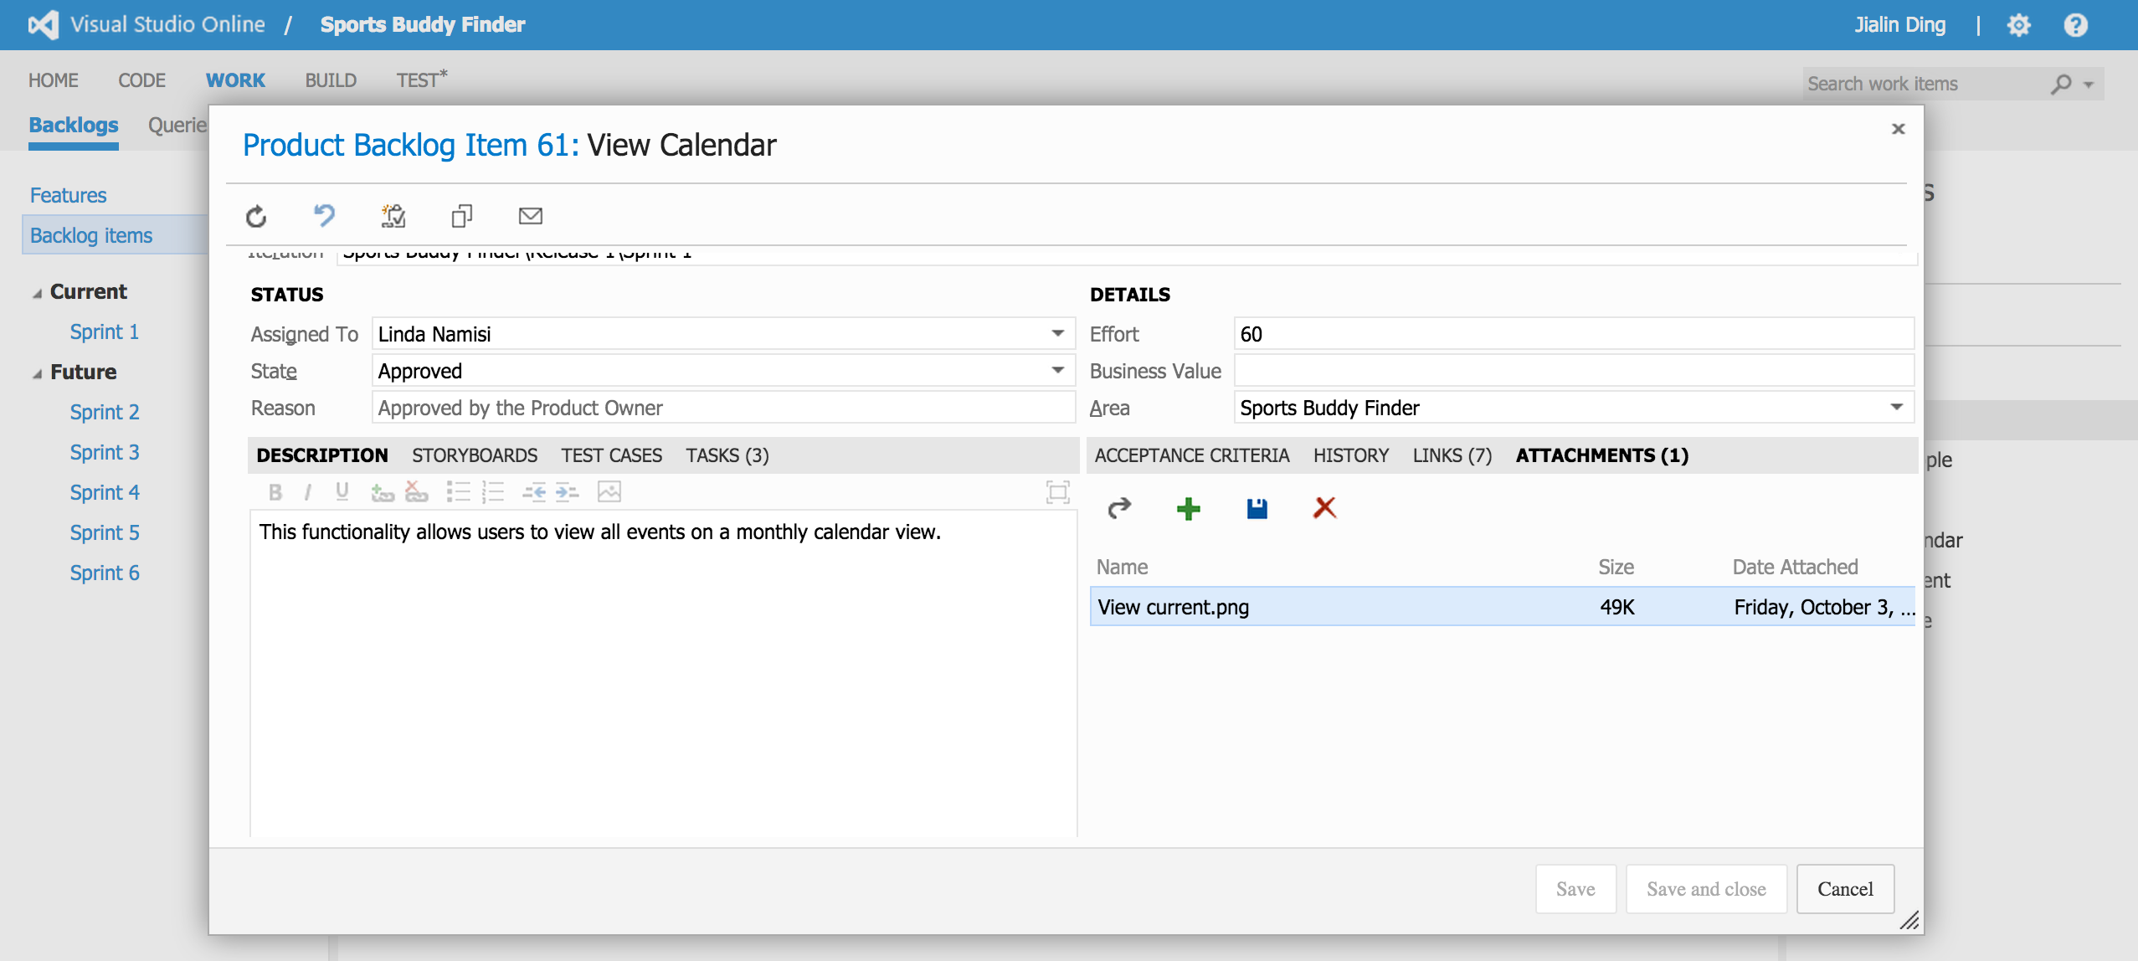
Backlog Item Detail
Linked to storyboard !

Slide 7
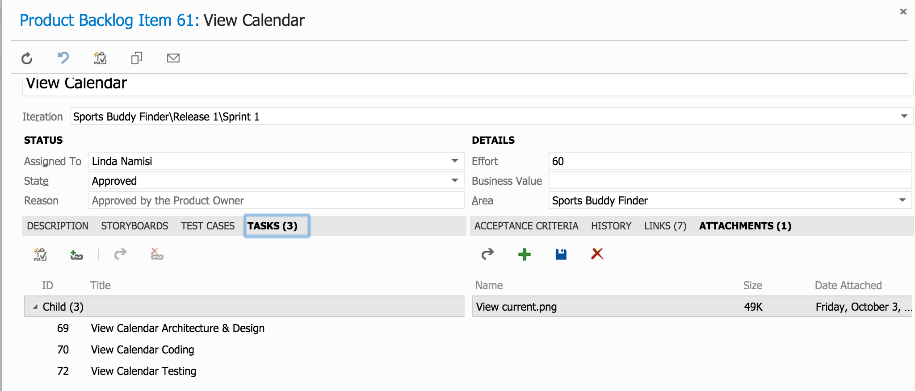
Backlog Item Tasks

Slide 8
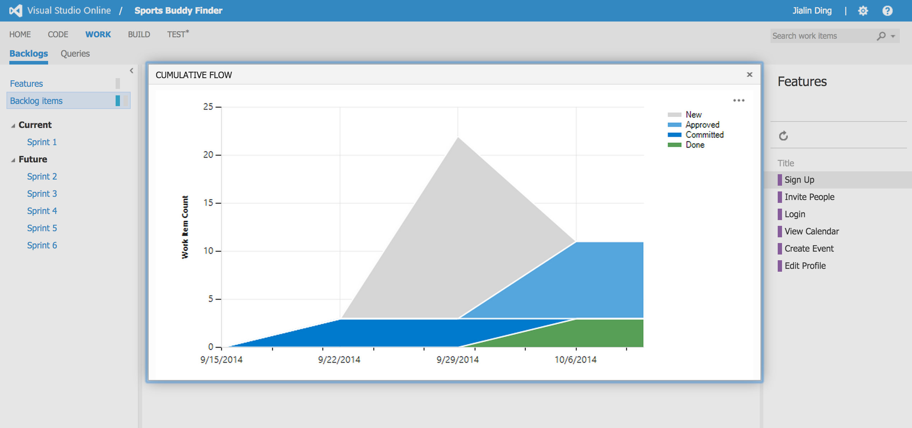
Backlog Items – Cumulative Flow

Slide 9
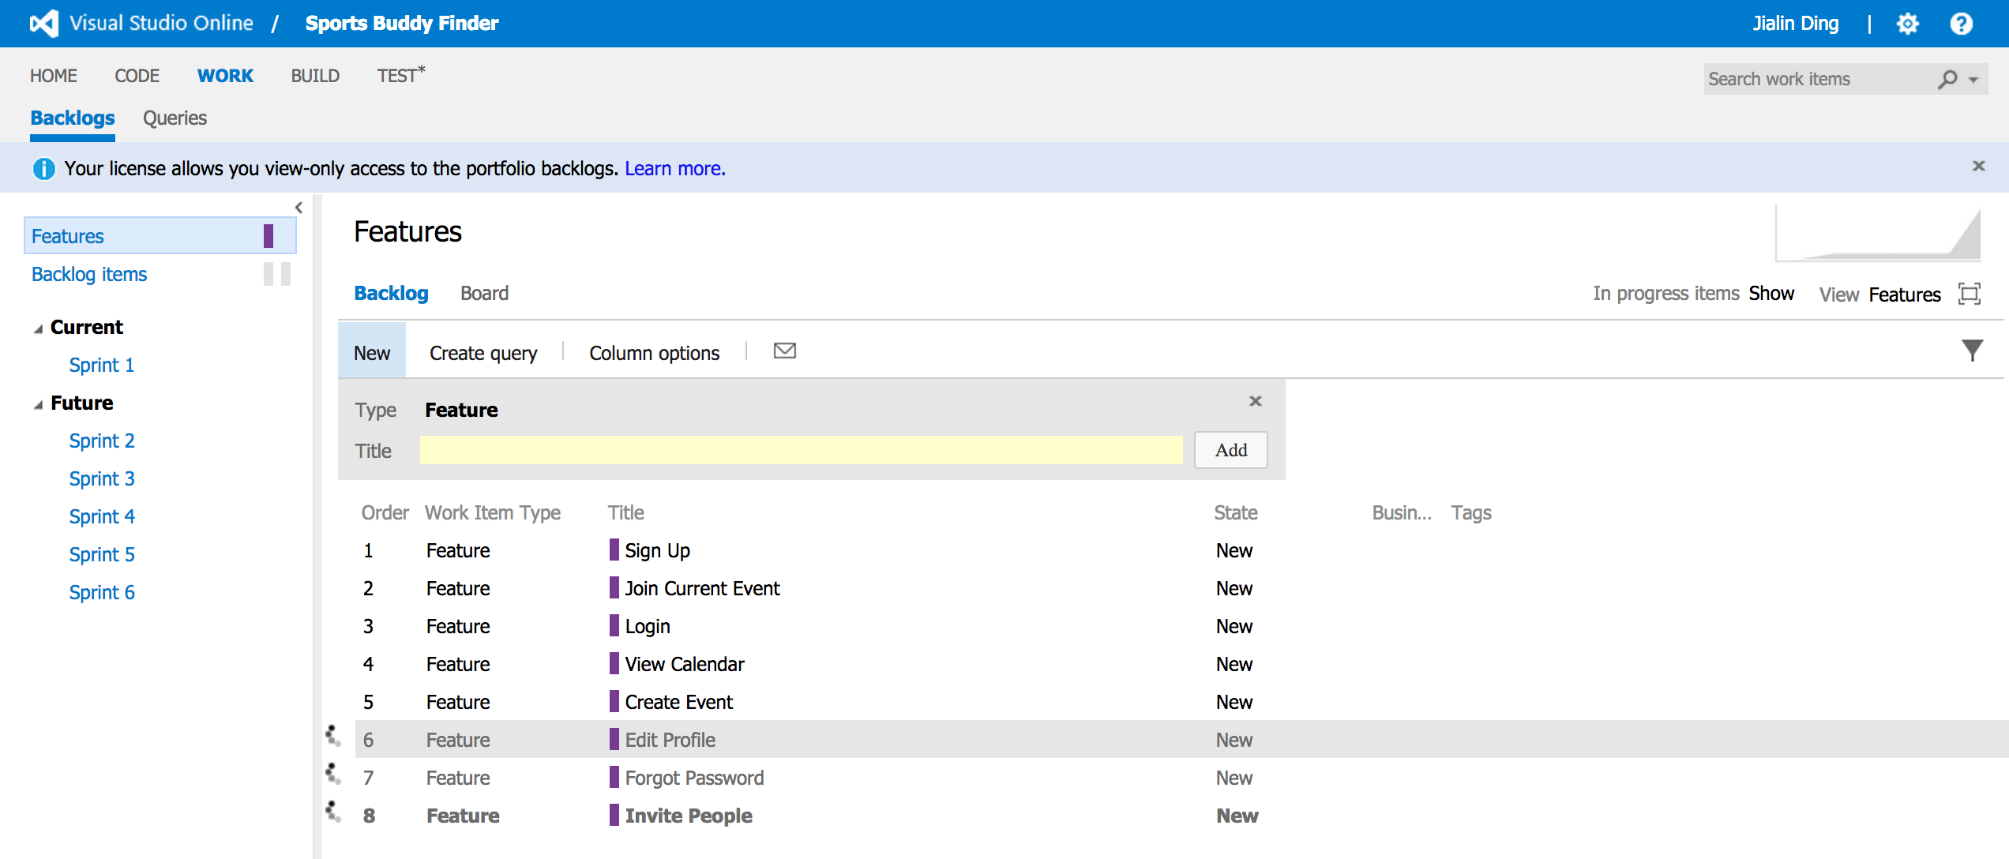
Features

Slide 10
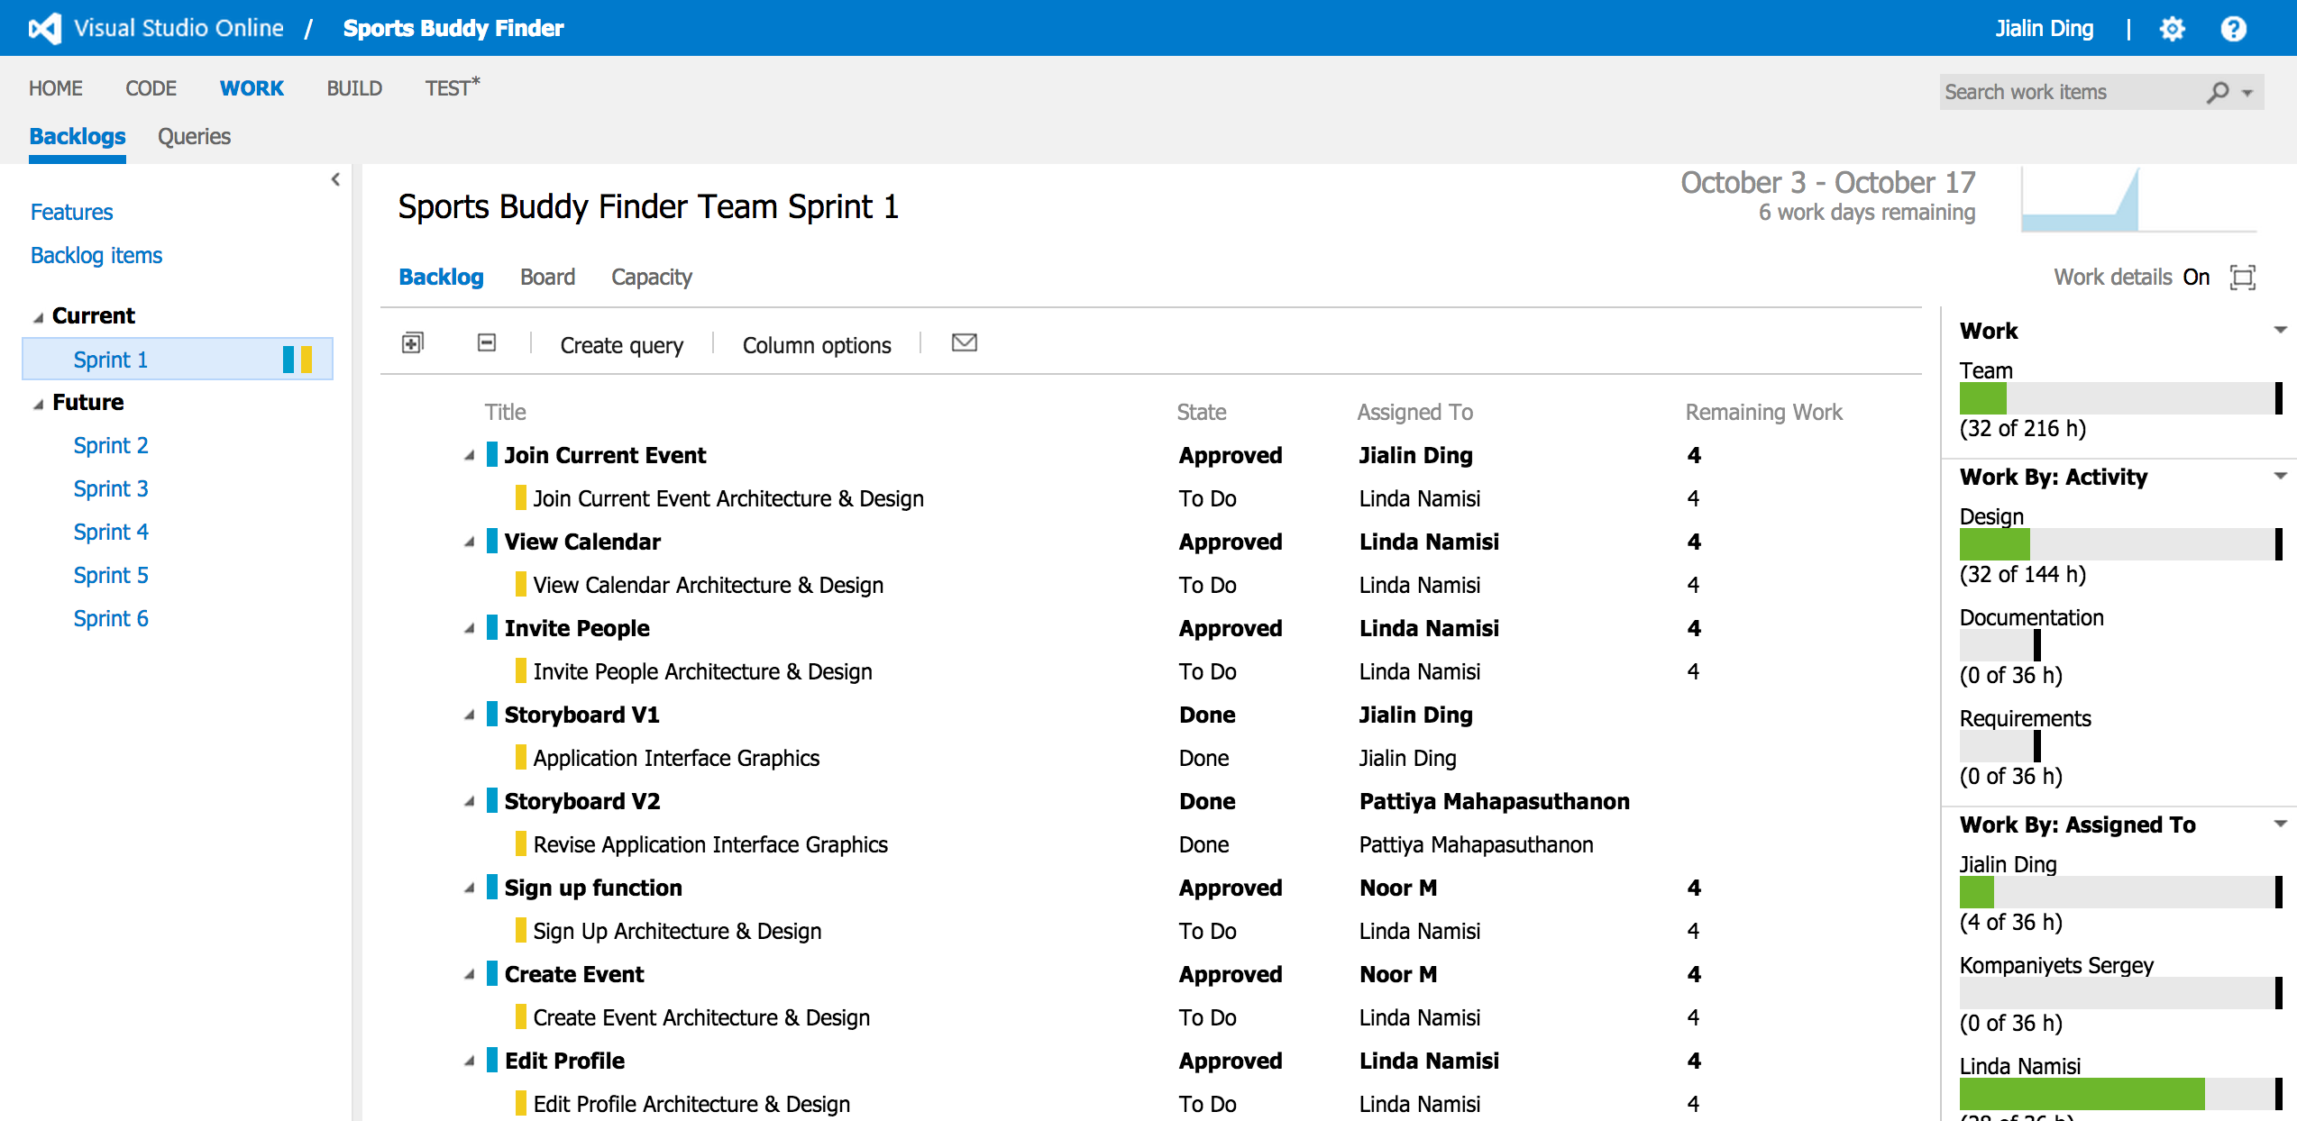
Sprint 1

Slide 11
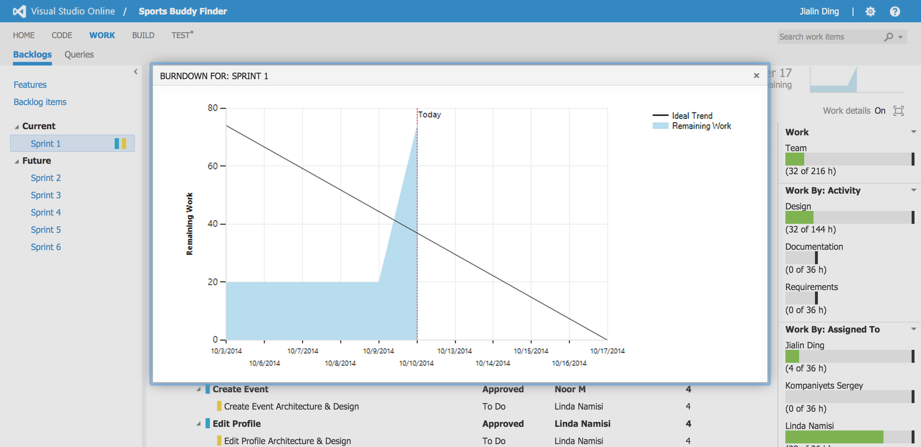
Burn Down For Sprint 1

Slide 12
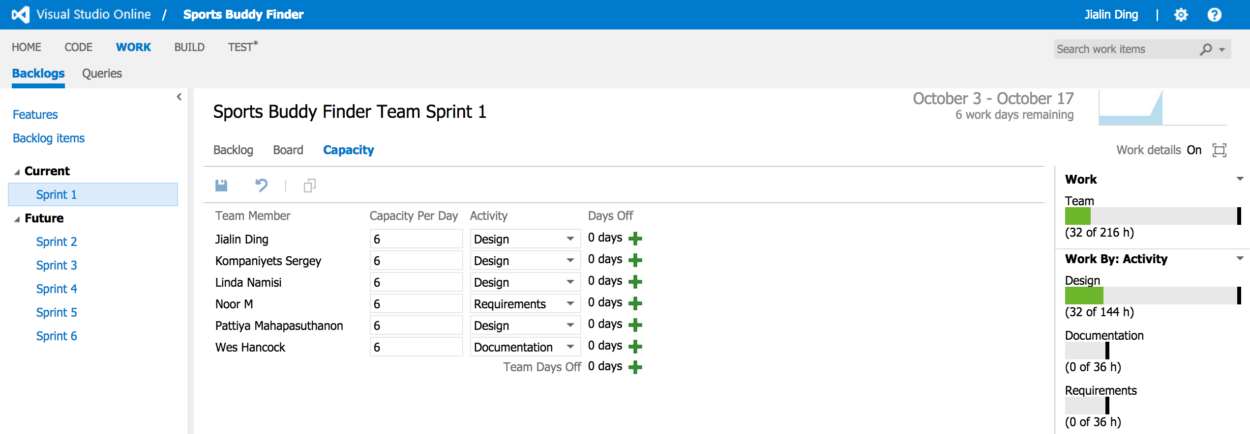
Sprint 1Capacity For Team Members

Slide 13
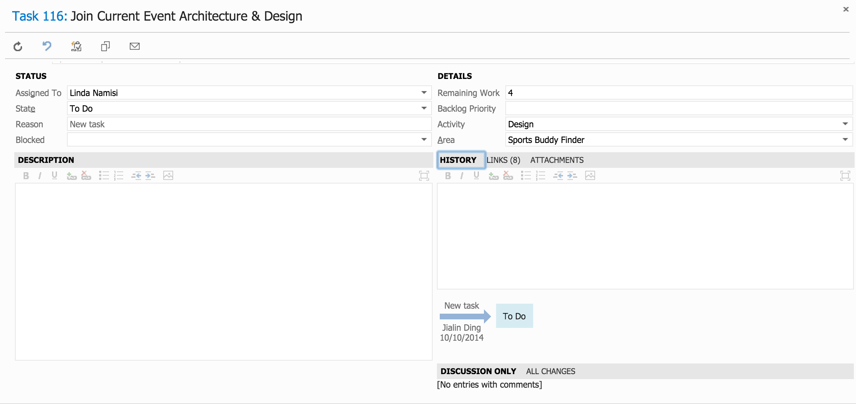
Sprint 1 Architecture Task

Slide 14
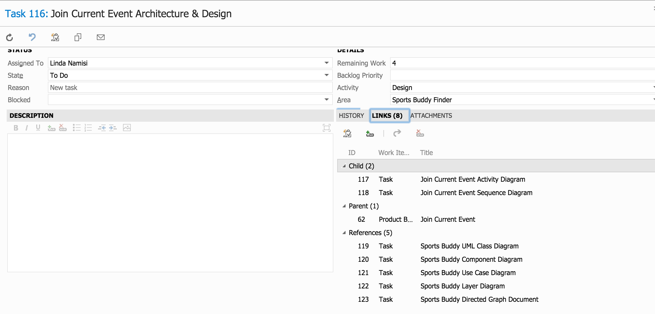
Sprint 1 Architecture Sub-Tasks

Slide 15
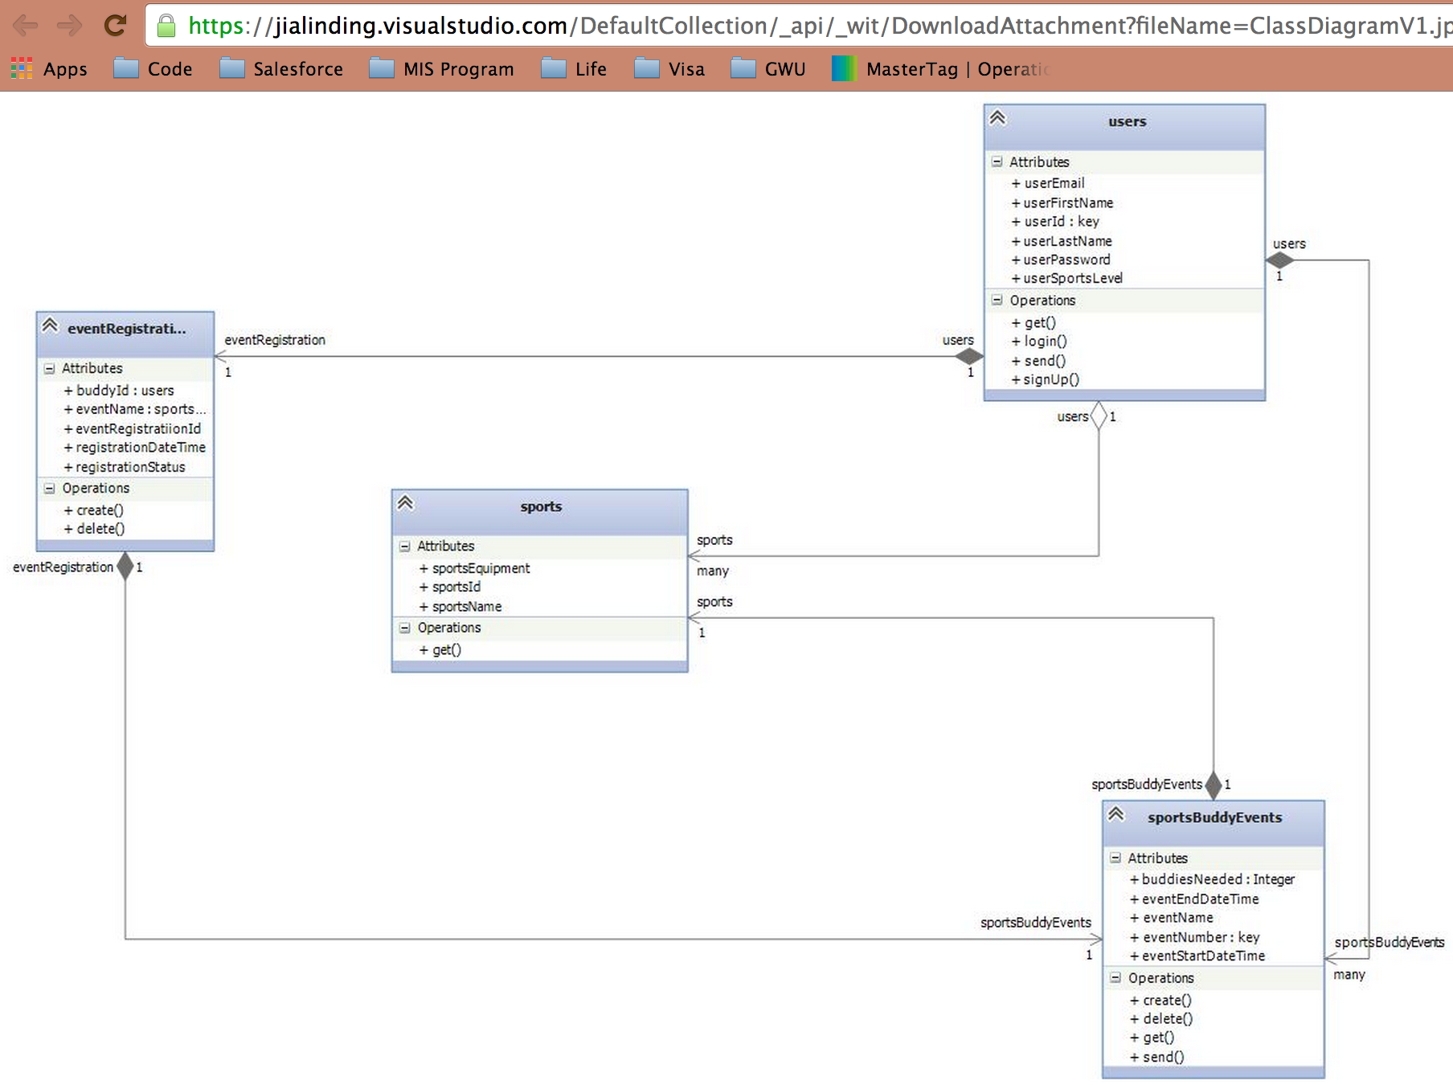
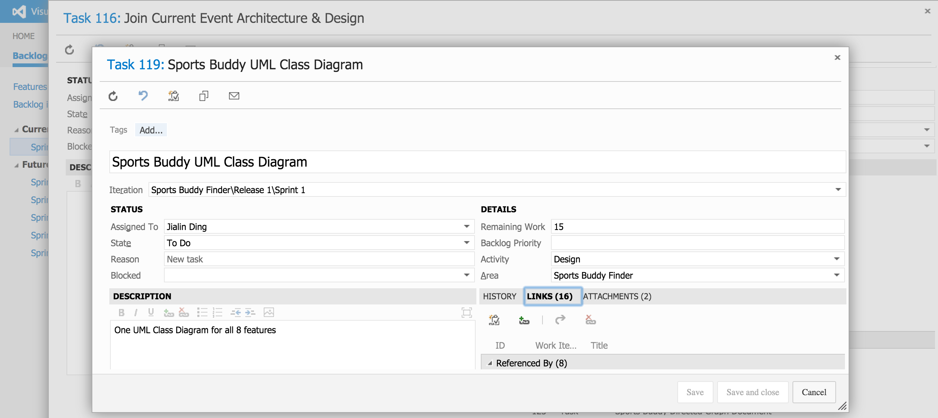
Sprint 1 Architecture Class Diagram

Slide 16
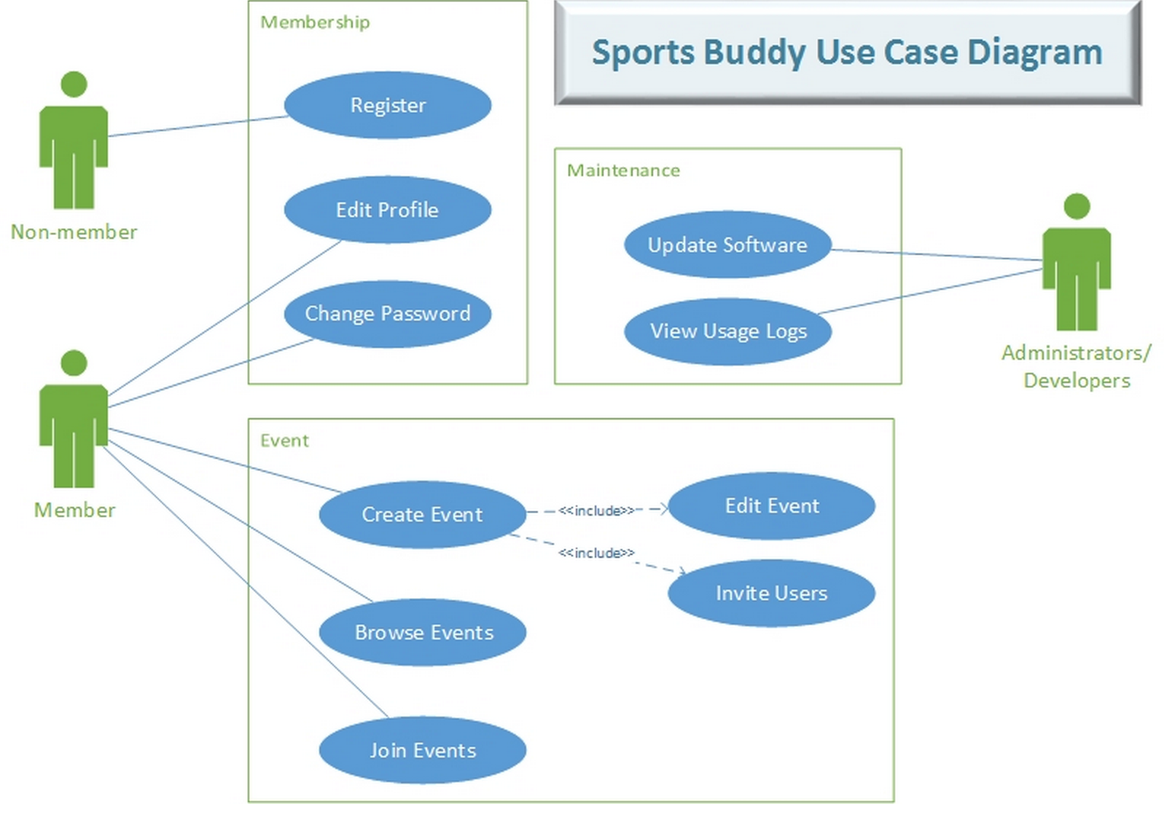
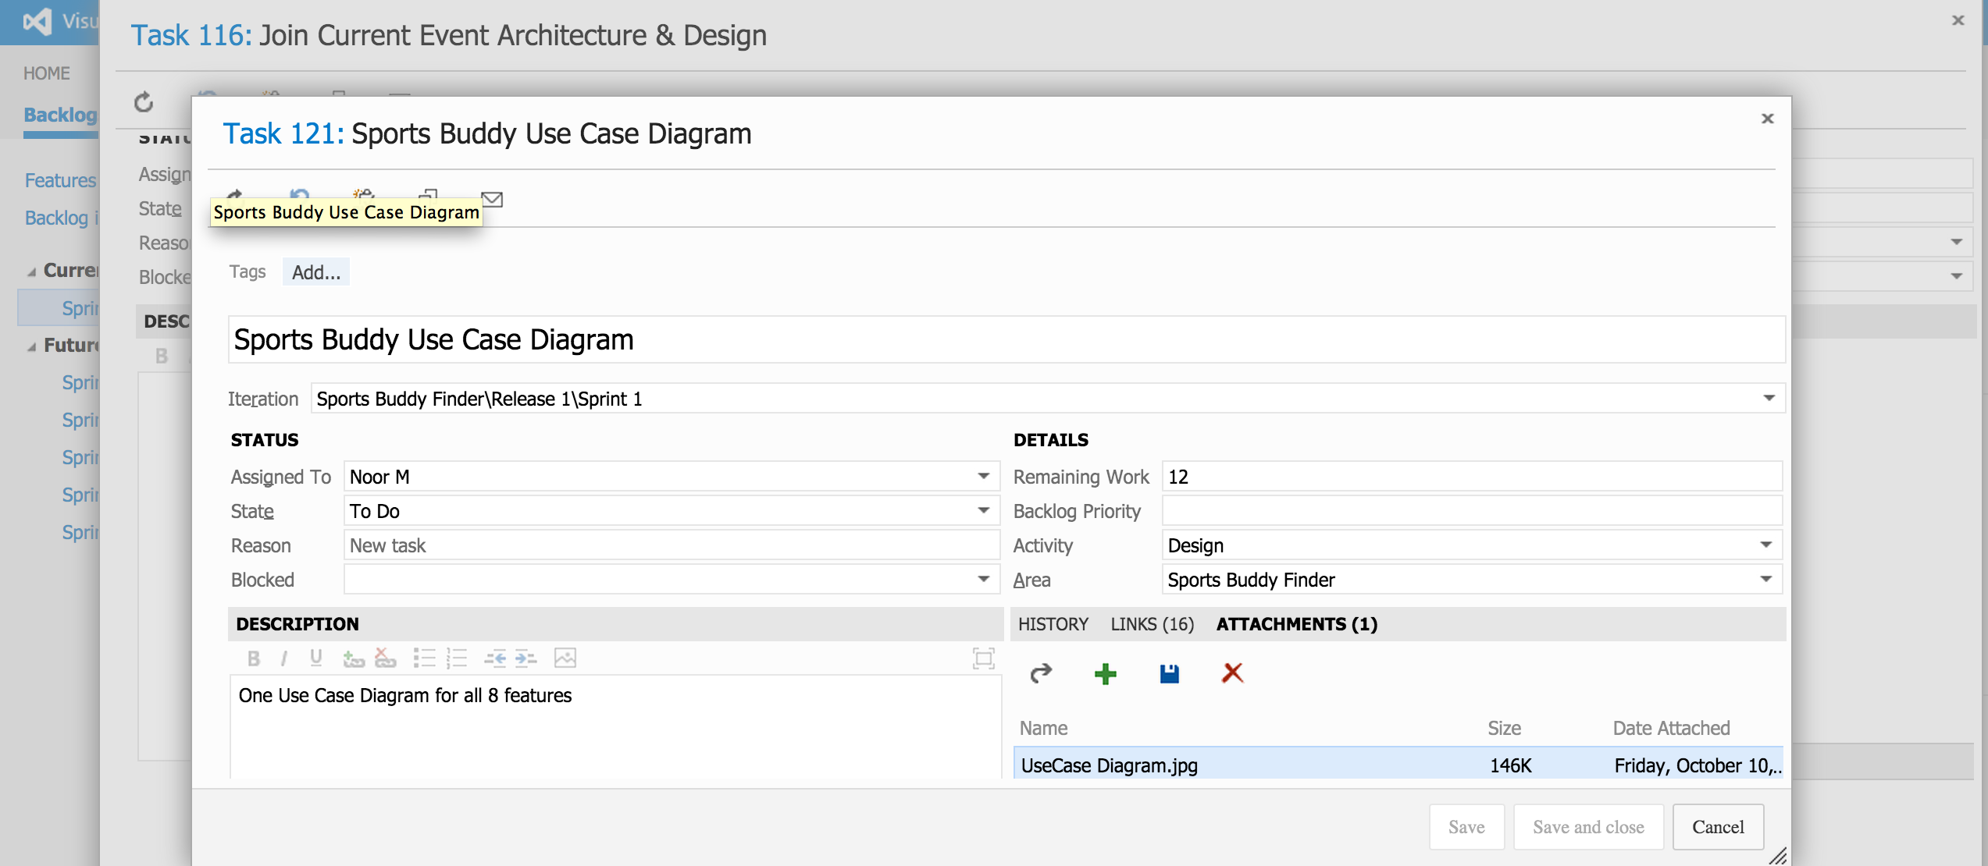
Sprint 1 Architecture Use Case Diagram

Slide 17
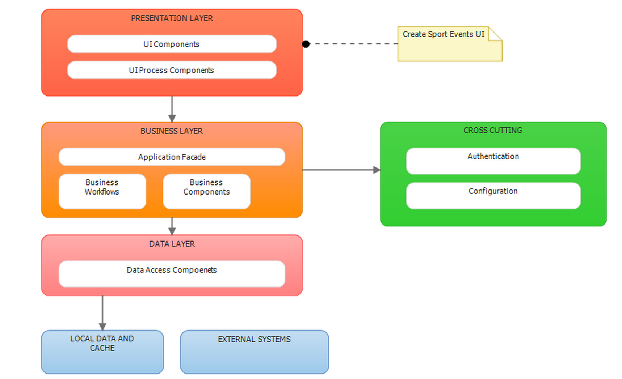
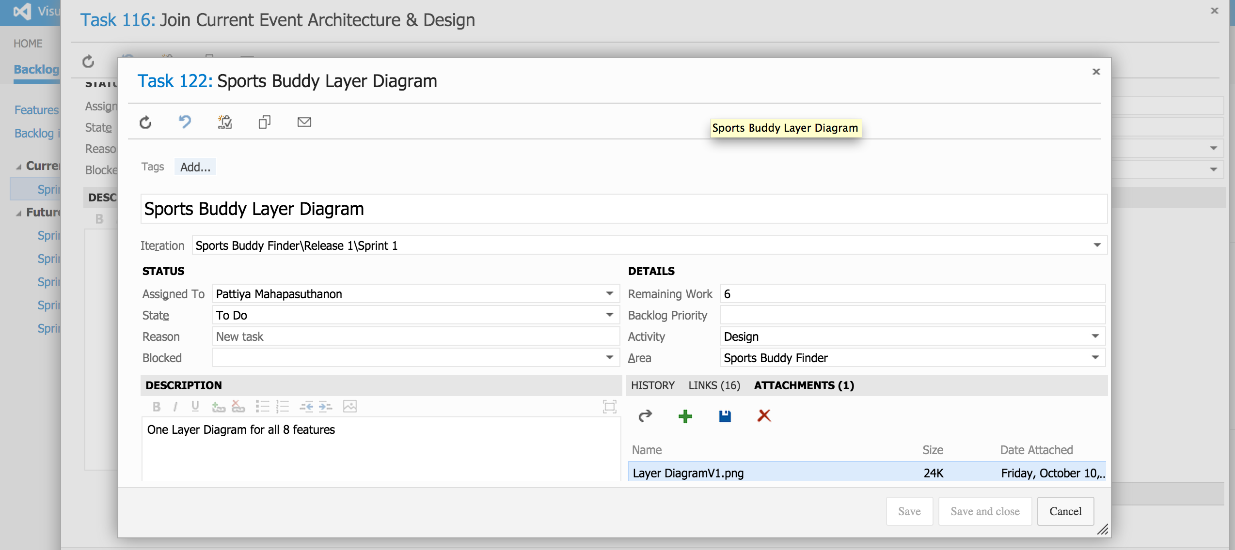
Sprint 1 Architecture Layer Diagram

Slide 18
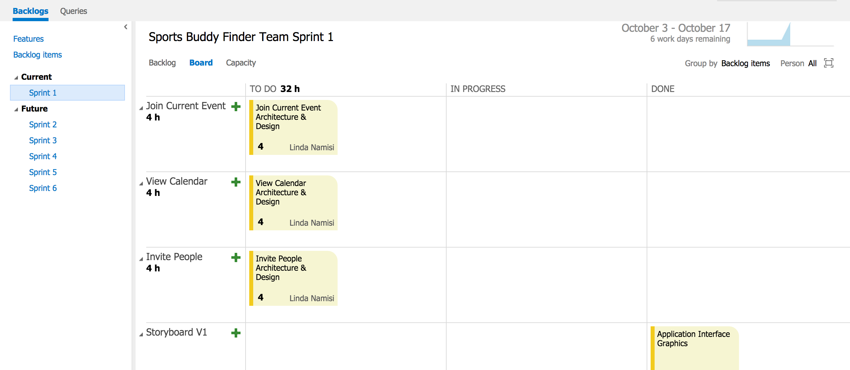
Sprint 1 Board

Slide 19
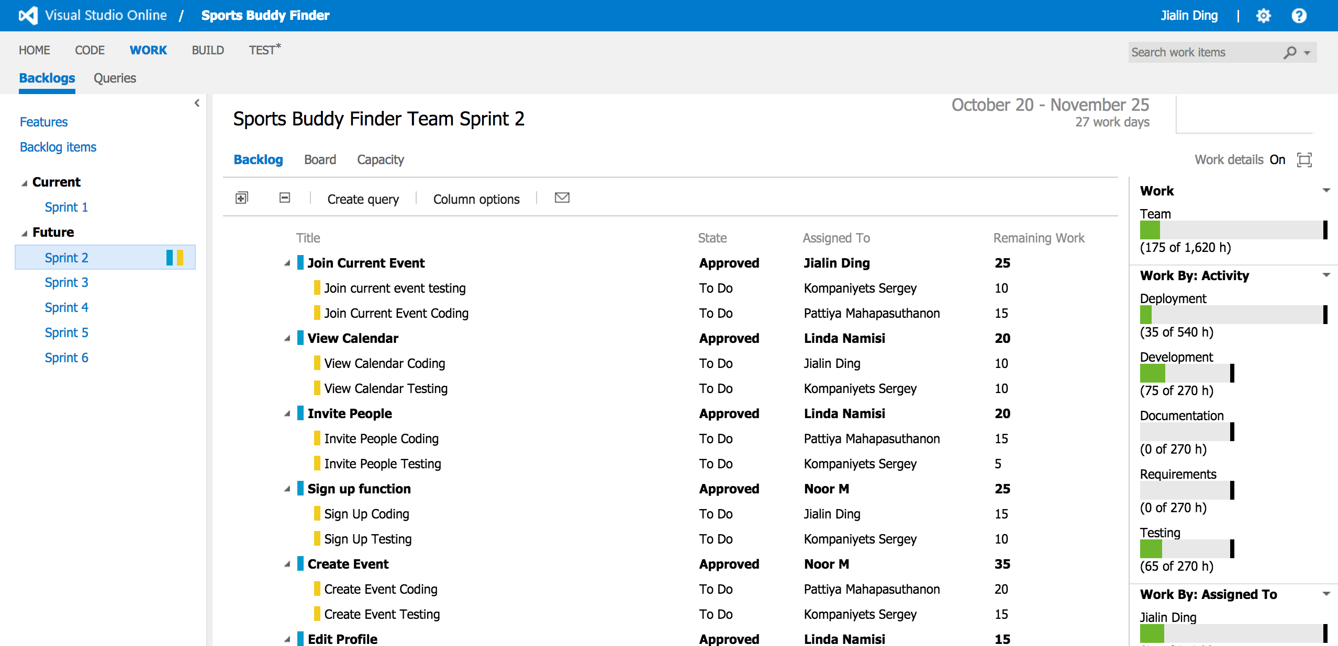
Sprint 2

